Slide 1





3D Visualization with the ArcGIS API for JavaScript
Kristian Ekenes & Johannes Schmid
Notes:
G97350 UC Template for Esri staff

Slide 2


Discover how to visualize geodata in a meaningful way in 3D using ArcGIS API for JavaScript

Slide 3
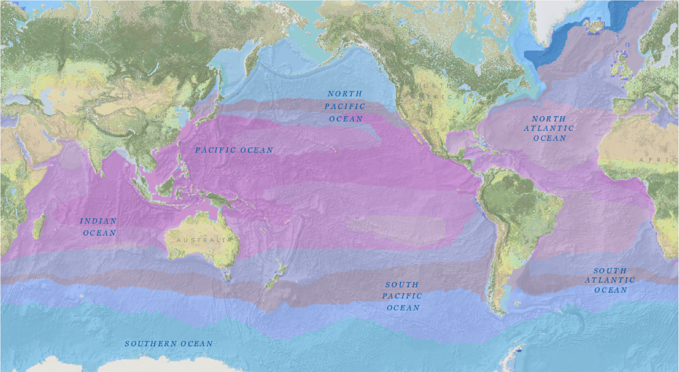

Slide 4
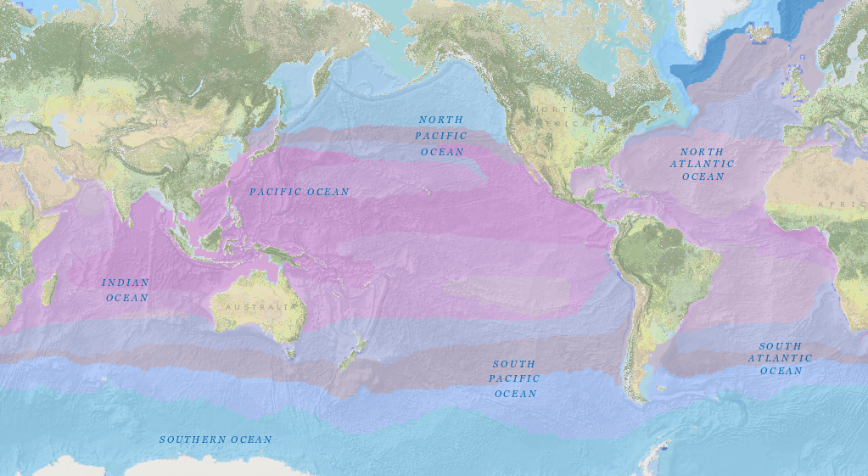

Slide 5
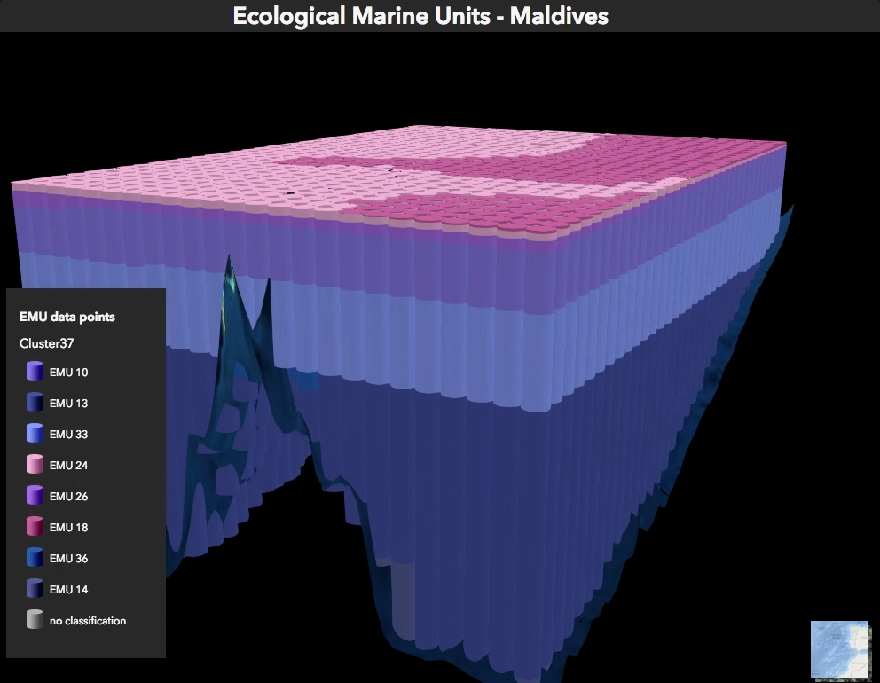

Slide 6
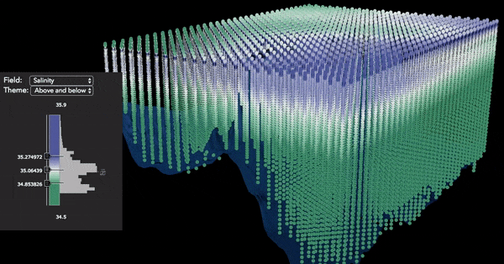

Slide 7
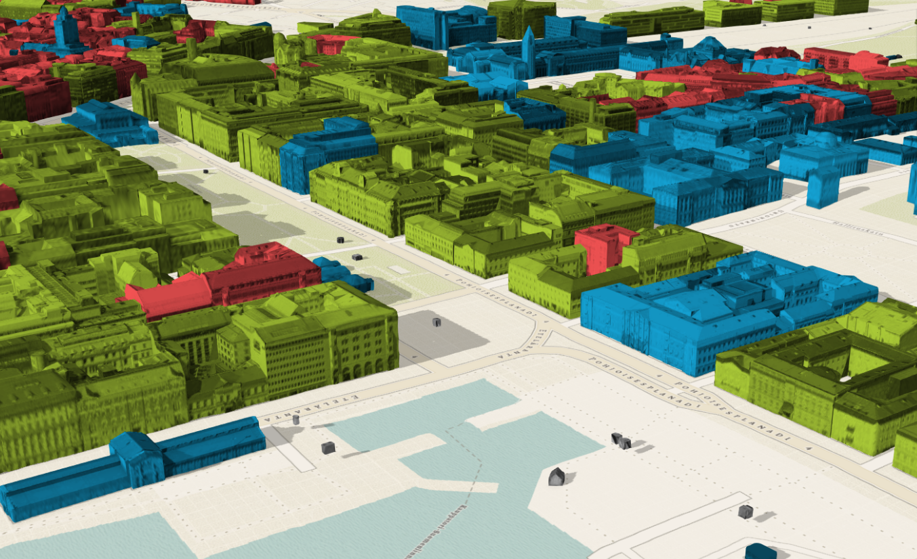
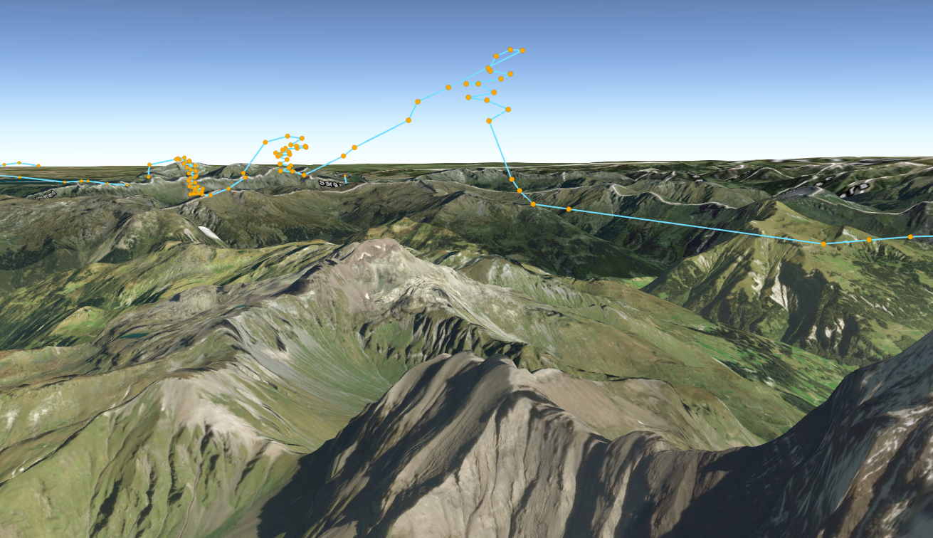
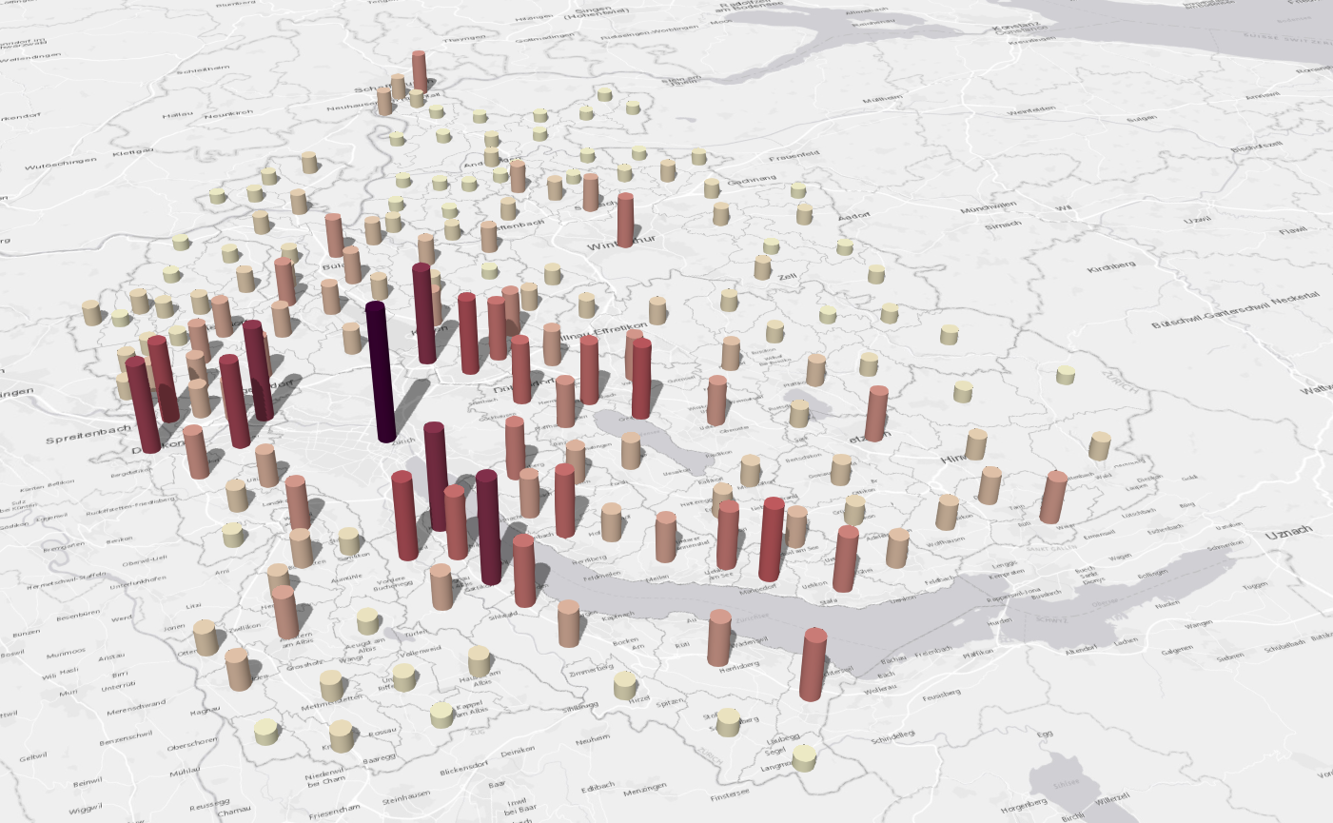
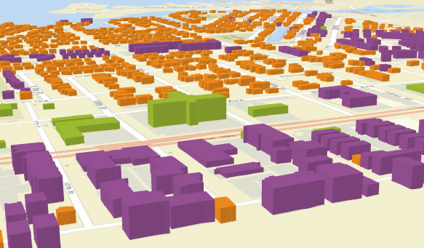
What can you visualize?
Location
Types
Data (numbers)
Combinations of the above

Slide 8
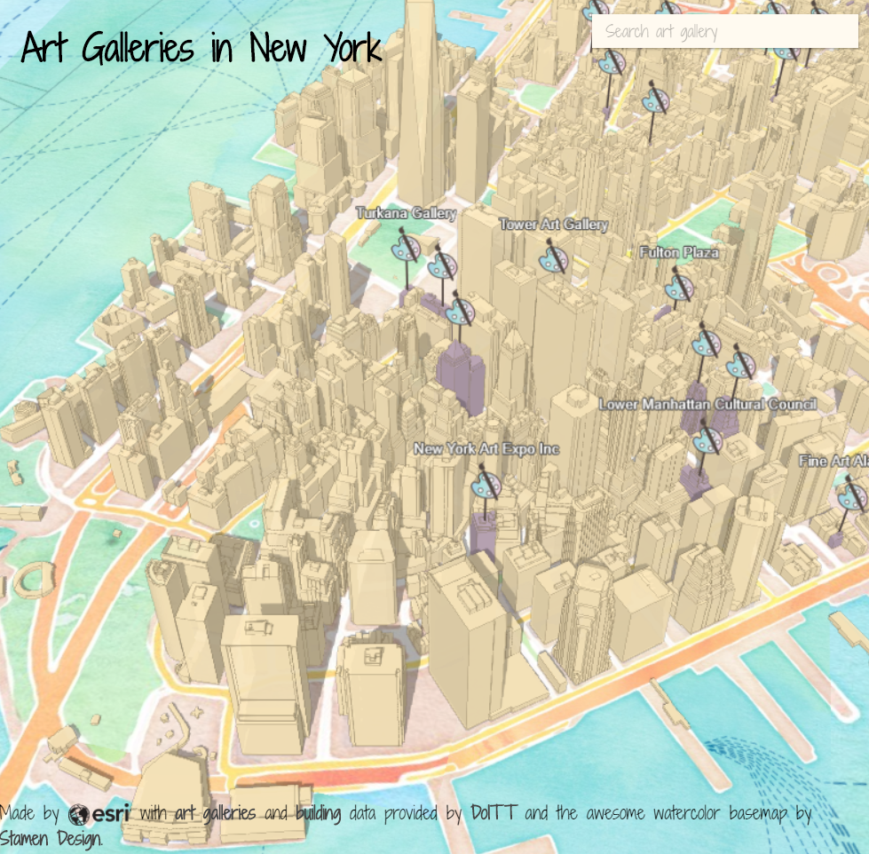
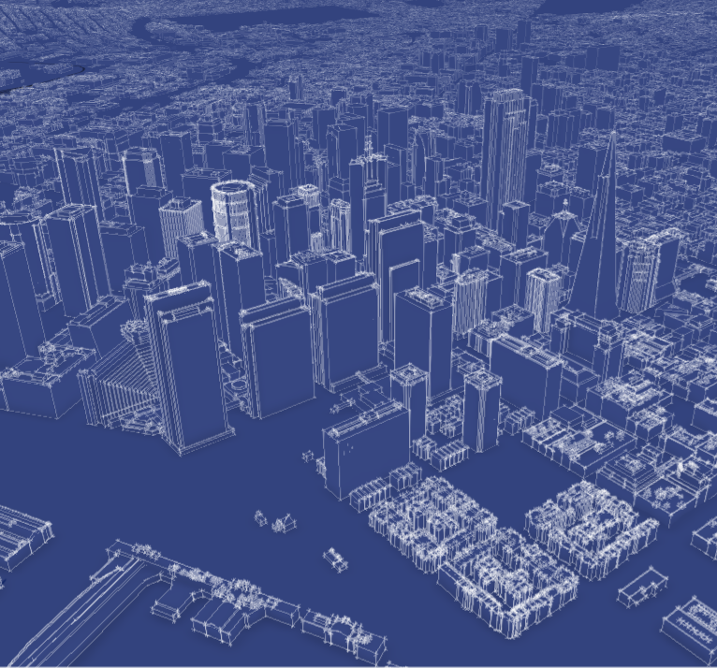
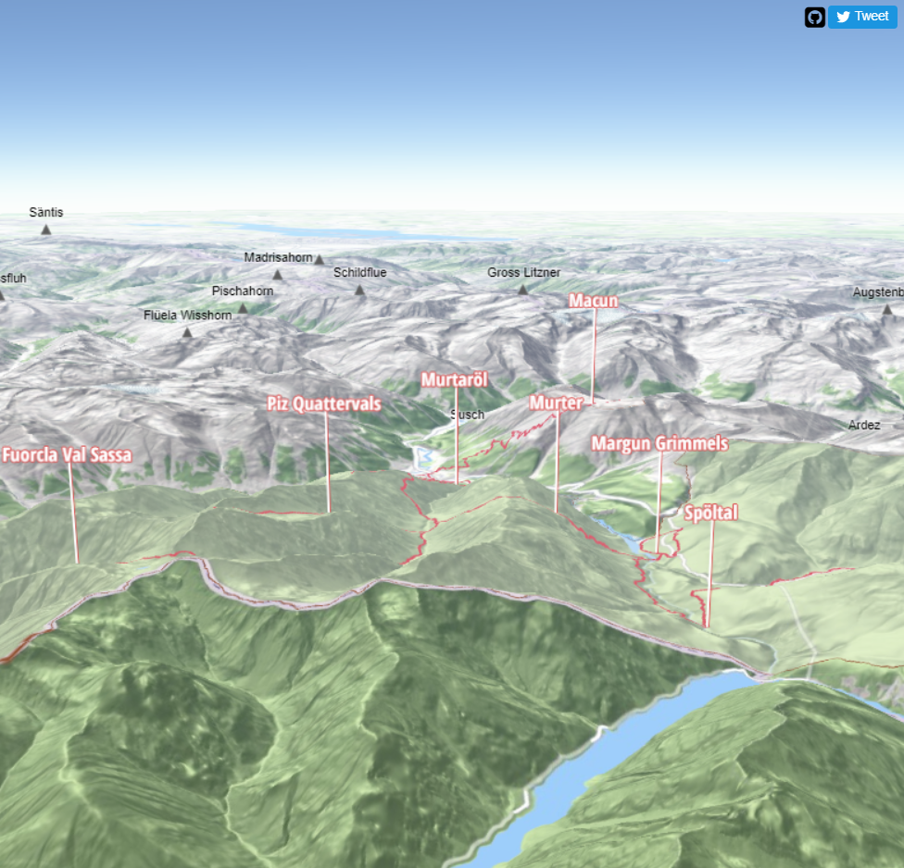
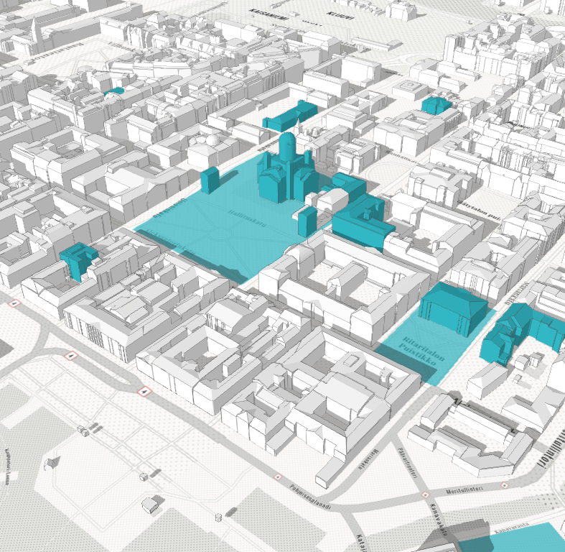

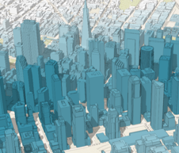
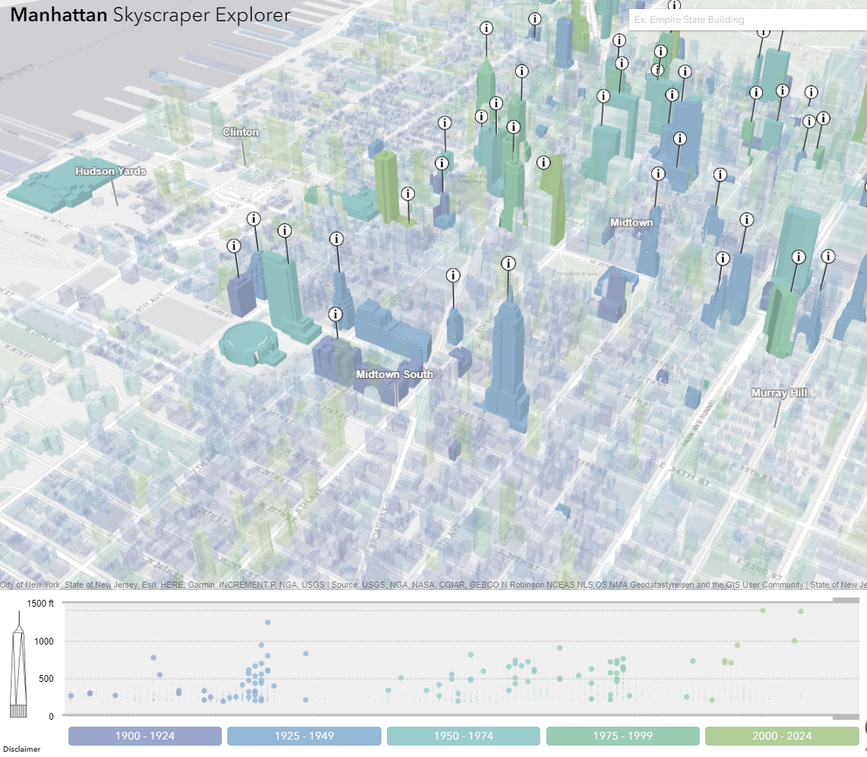
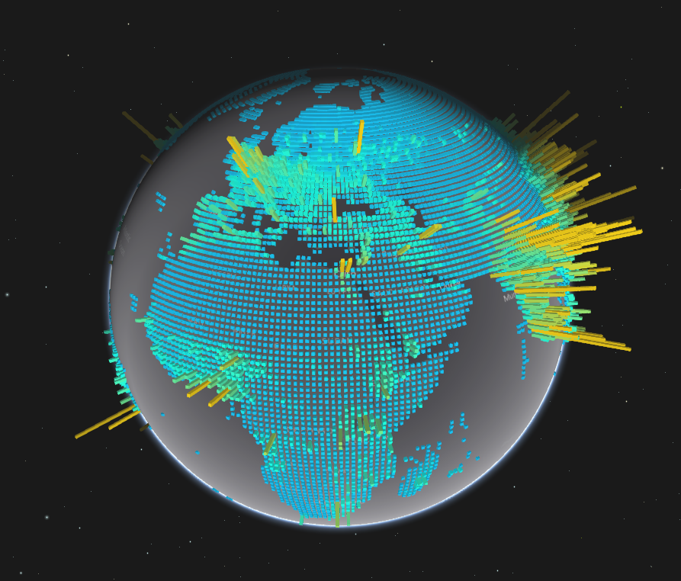


Slide 9
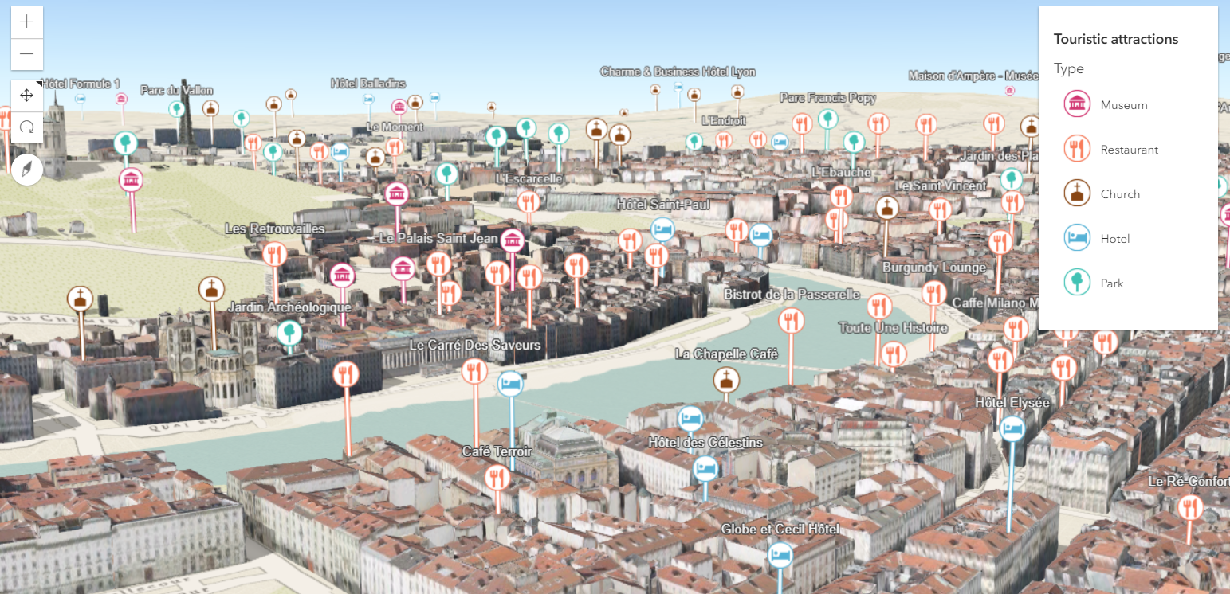
Points of interest in a city

Slide 10
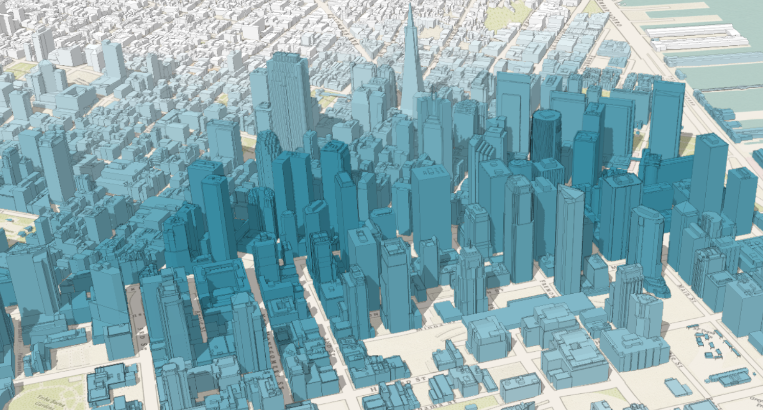
City thematic visualization

Slide 11
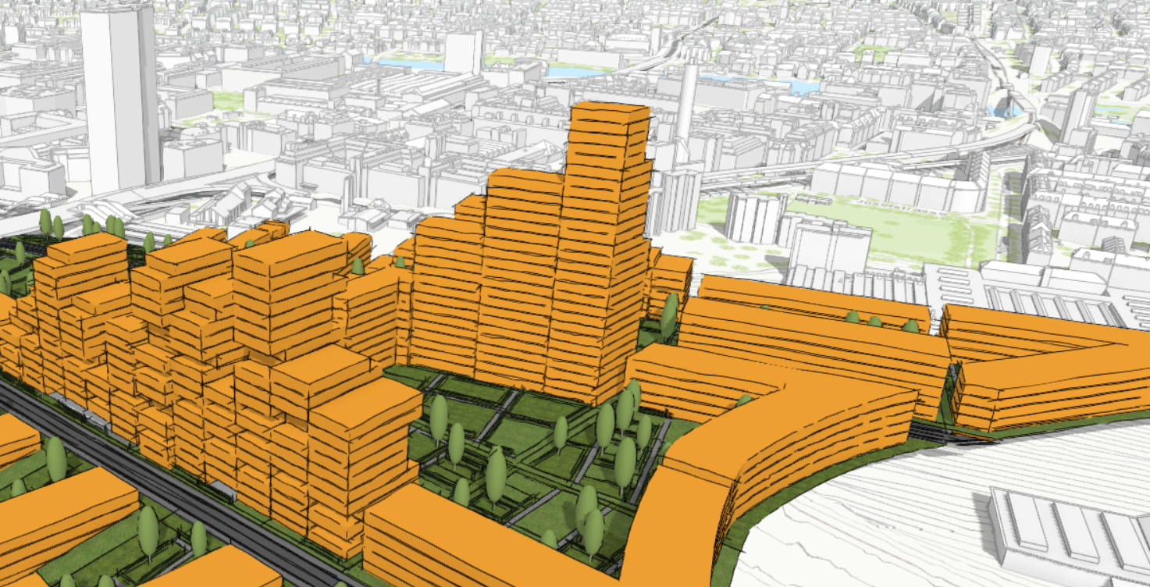
Urban Development

Slide 12
Data
FeatureLayer
MapImageLayer
SceneLayer
Includes 2D data sources
CSVLayer
PointCloudLayer
StreamLayer

Slide 13


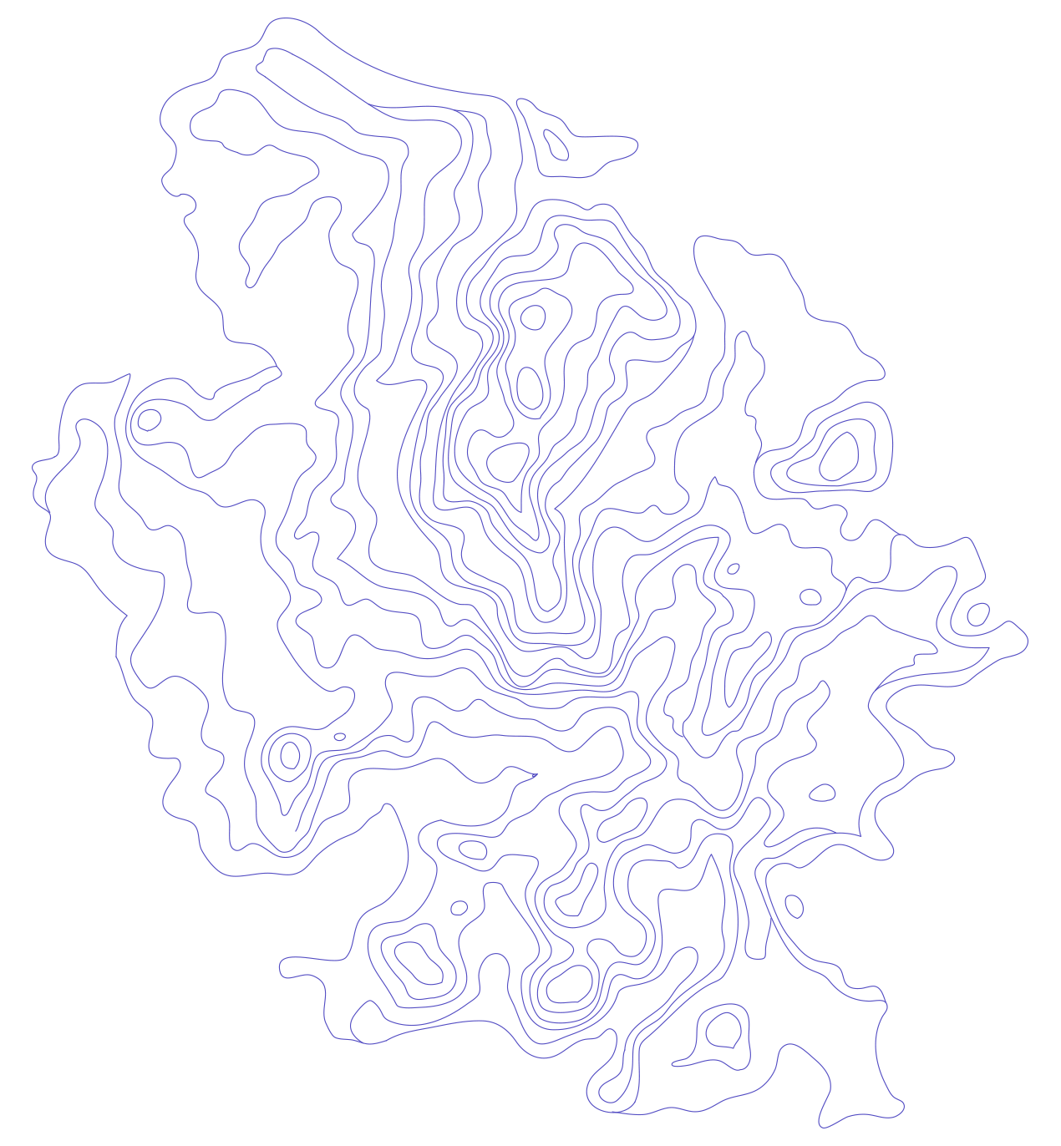


API Overview
renderers, symbols, symbol layers…
Notes:
G97350 UC Template for Esri staff

Slide 14
Data-driven visualization
Renderers & Visual Variables
Field value(s) TOTAL_POP
Arcade expression Round( ($feature.BACHELOR + $feature.MASTER) / $feature.POP_25UP) );
JavaScript function function (graphic){ return graphic.attributes.POP_DENSITY; }

Slide 15
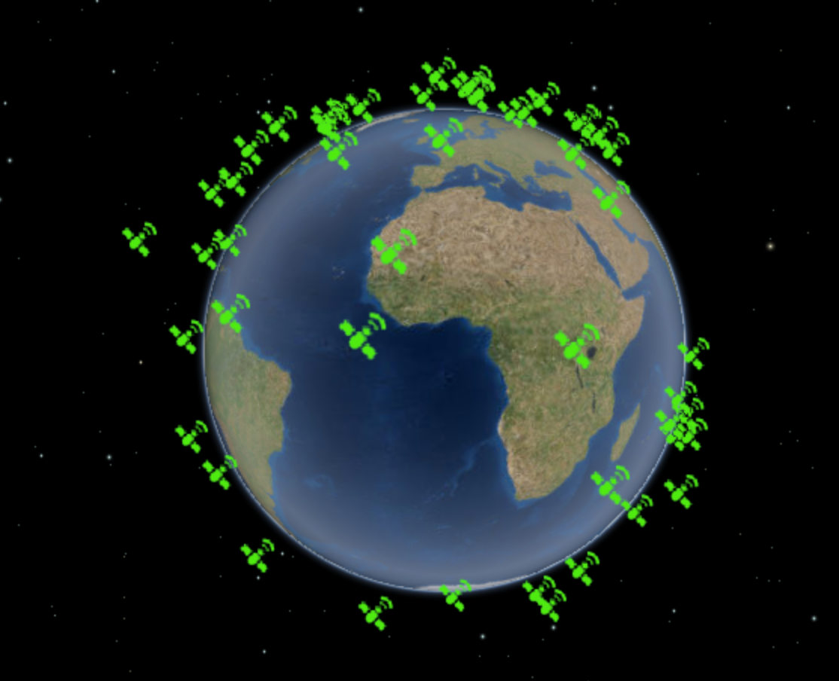
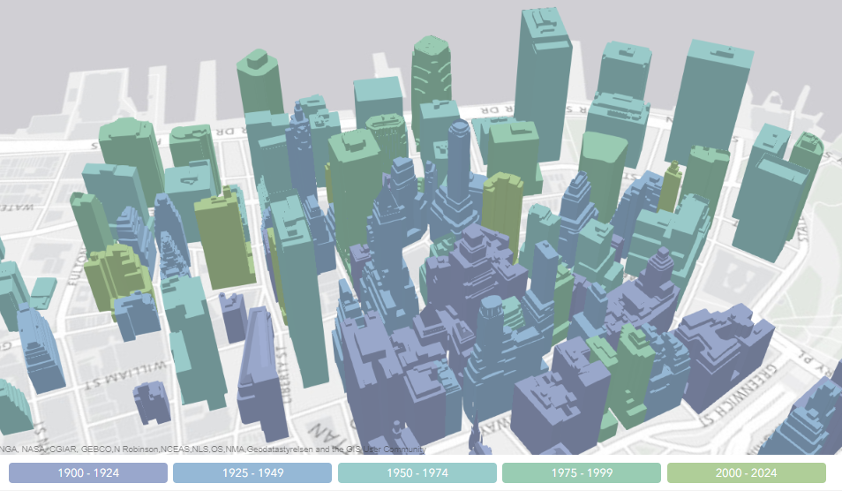
Renderers
SimpleRenderer
UniqueValueRenderer
ClassBreaksRenderer

Slide 16

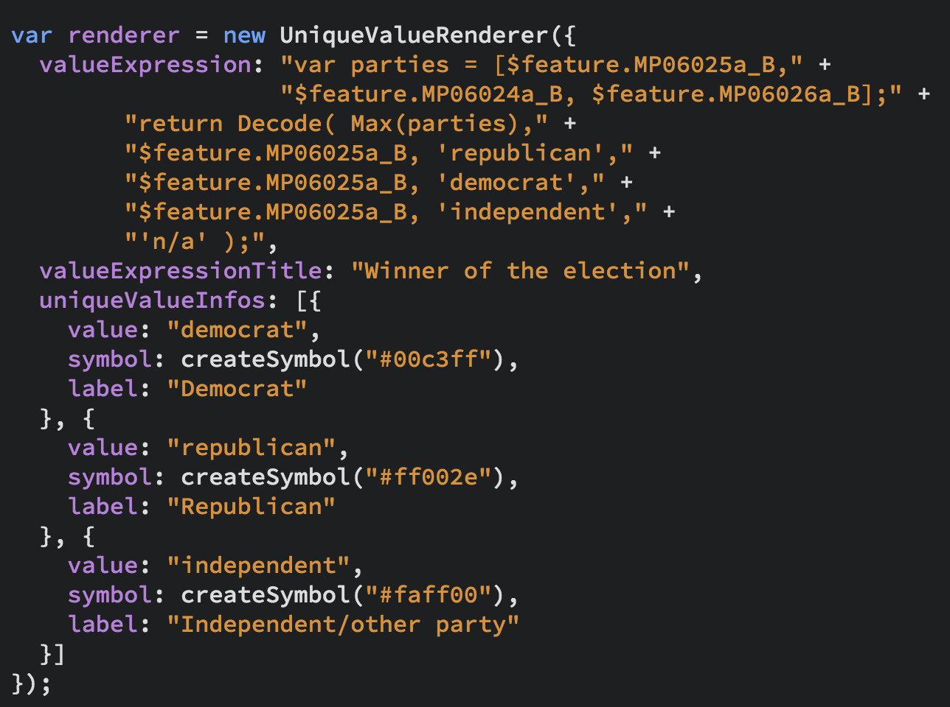
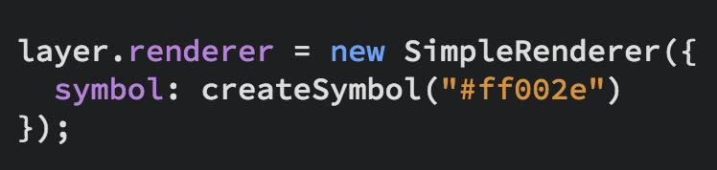
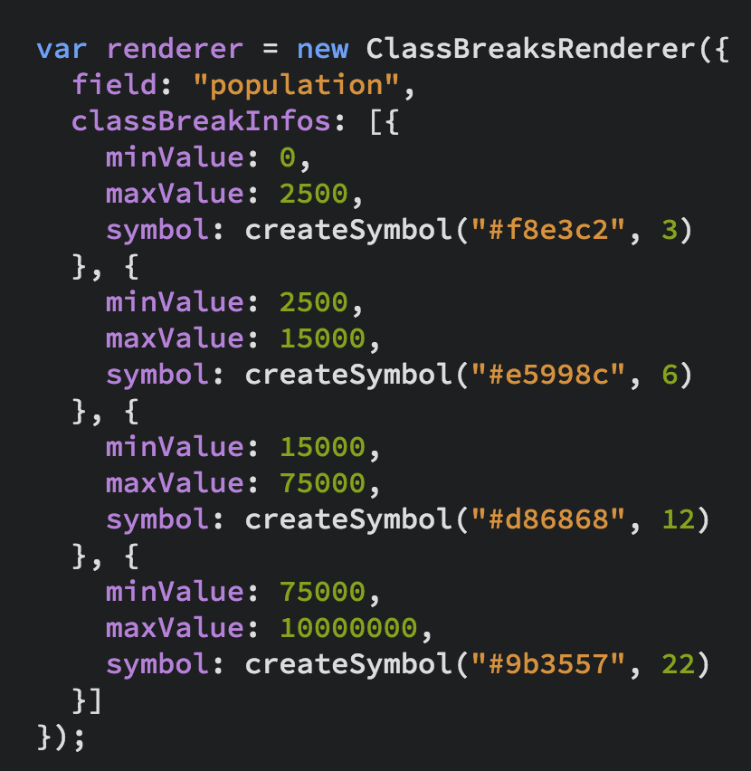
UniqueValueRenderer
Renderers
SimpleRenderer
ClassBreaksRenderer
…and PointCloud Renderers

Slide 17
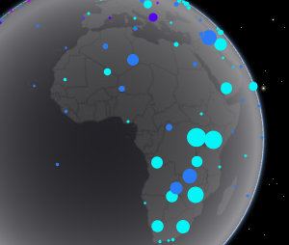
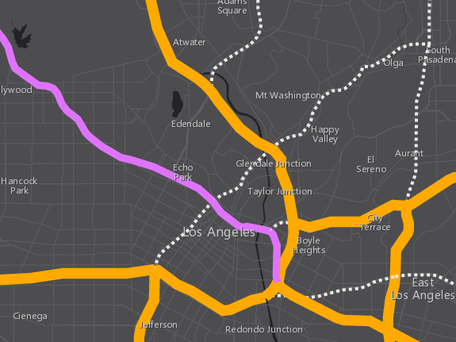
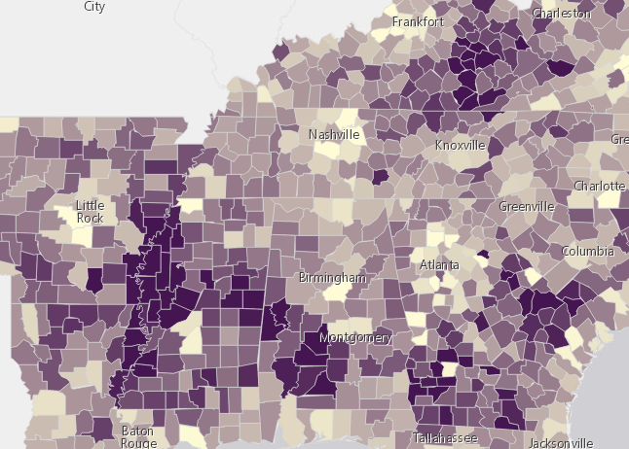
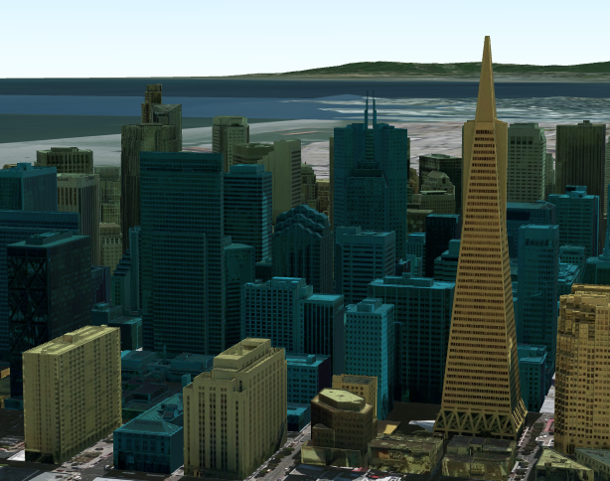
3D Symbols
based on geometry type
Points
Lines
Polygons
Mesh
PointSymbol3D
LineSymbol3D
PolygonSymbol3D
MeshSymbol3D

Slide 18
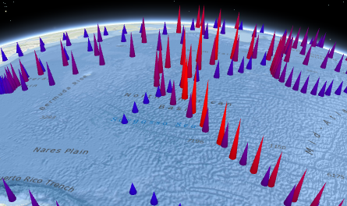
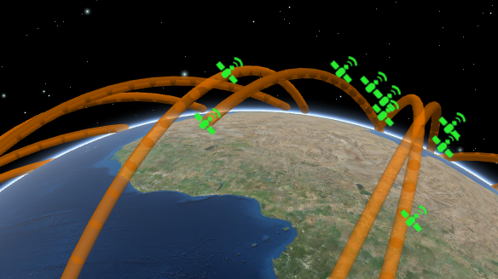
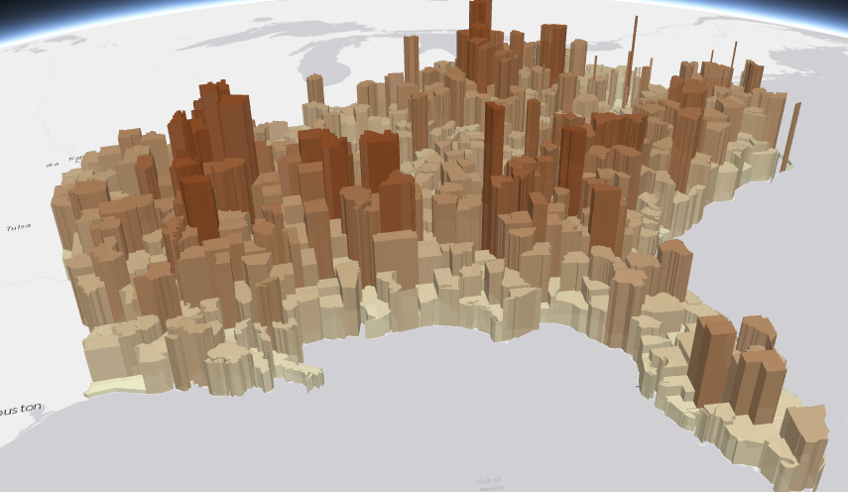
Symbols
PointSymbol3D
LineSymbol3D
PolygonSymbol3D
IconSymbol3DLayer
LineSymbol3DLayer
FillSymbol3DLayer
Flat
- Screen size units (pt, px)
- Graphics are in screen space
PathSymbol3DLayer
ExtrudeSymbol3DLayer
Volumetric
- Real world units (feet, meter)
- Graphics are in real world space
ObjectSymbol3DLayer

Slide 19
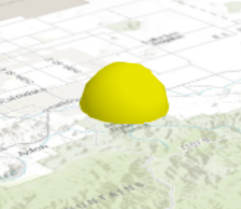
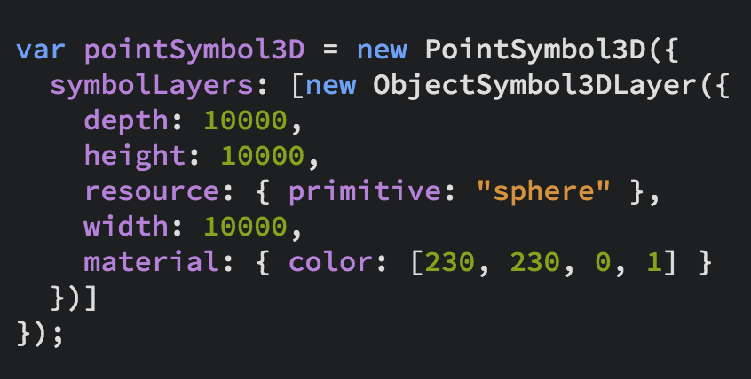
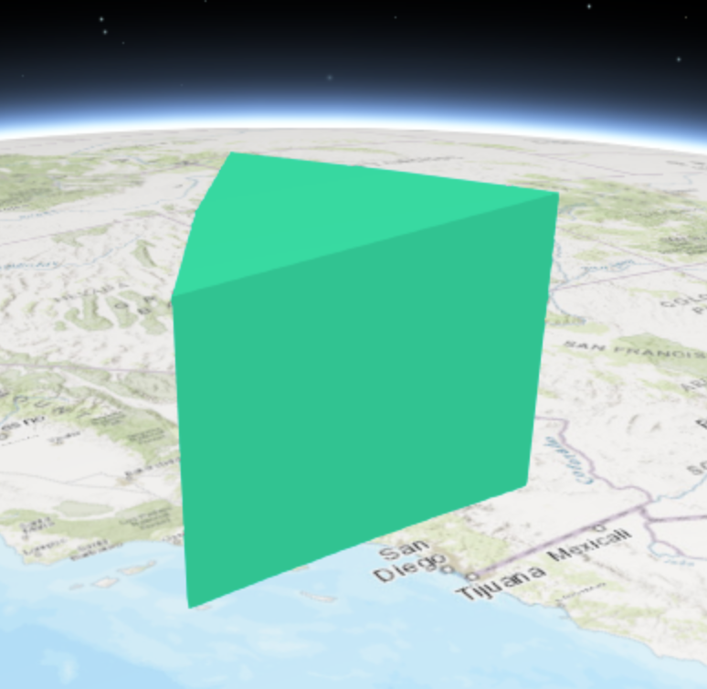
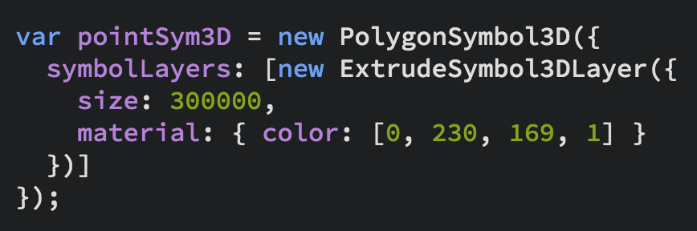
3D Symbols

Slide 20
layer
var layer = new FeatureLayer({
renderer: new SimpleRenderer({
symbol: new PointSymbol3D({
symbolLayers: [new IconSymbol3DLayer({…})]
})
}),
elevationInfo: {
mode: "relative-to-scene"
},
labelingInfo: [{
symbol: new LabelSymbol3D({
symbolLayers: [new TextSymbol3DLayer({…})]
})
}]
});
renderer
symbol
symbolLayers

Slide 21
var layer = new FeatureLayer({
renderer: new SimpleRenderer({
symbol: new PointSymbol3D({
symbolLayers: [new IconSymbol3DLayer({…})]
}),
visualVariables: [{
type: "size",
field: "TOTPOP_CY",
normalizationField: "SQMI",
stops: [{
value: 4000,
size: 6
},
{
value: 23000,
size: 40
}]
}]
});
renderer
symbol
symbolLayers
visualVariables
for numeric continuous visualizations

Slide 22
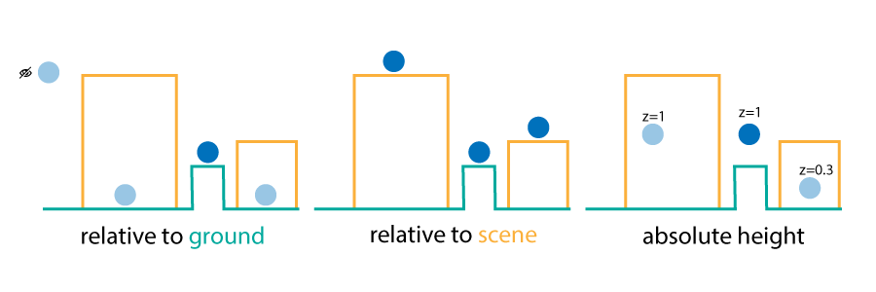
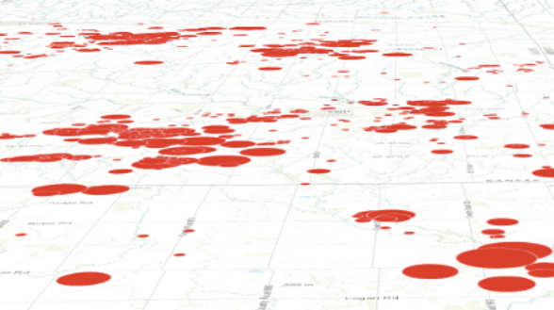
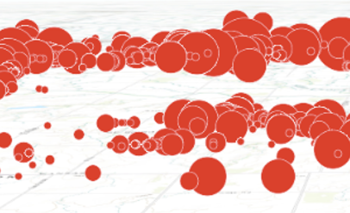
layer
elevationInfo
mode
on the ground
relative to ground

Slide 23
layer
var layer = new FeatureLayer({
renderer: new SimpleRenderer({
symbol: new PointSymbol3D({
symbolLayers: [new IconSymbol3DLayer({…})]
})
}),
elevationInfo: {
mode: "relative-to-scene"
},
labelingInfo: [{
symbol: new LabelSymbol3D({
symbolLayers: [new TextSymbol3DLayer({…})]
})
}]
});
elevationInfo
mode

Slide 24
layer
var layer = new FeatureLayer({
renderer: new SimpleRenderer({
symbol: new PointSymbol3D({
symbolLayers: [new IconSymbol3DLayer({…})]
})
}),
elevationInfo: {
mode: "relative-to-scene"
},
labelingInfo: [{
symbol: new LabelSymbol3D({
symbolLayers: [new TextSymbol3DLayer({…})]
})
}]
});
labelingInfo
symbol
symbolLayers

Slide 25
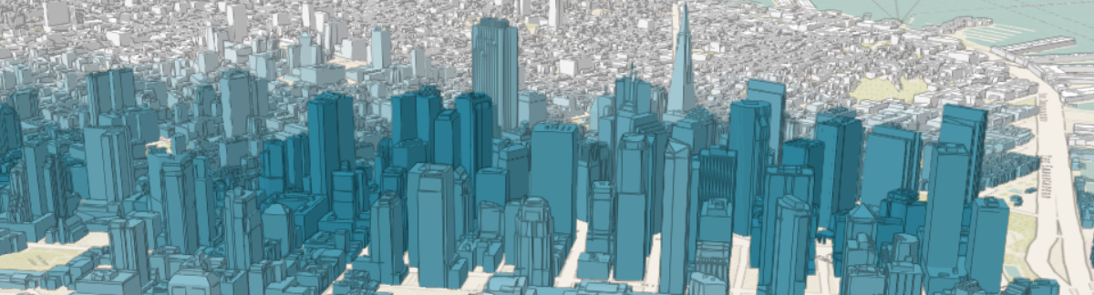
Symbols
MeshSymbol3D
FillSymbol3DLayer

Slide 26
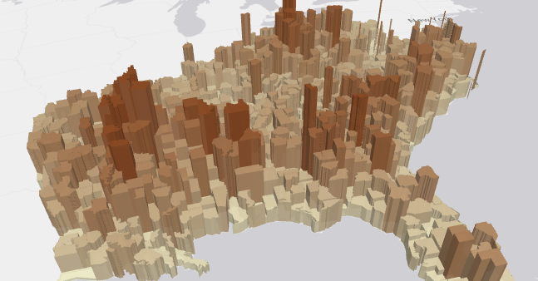
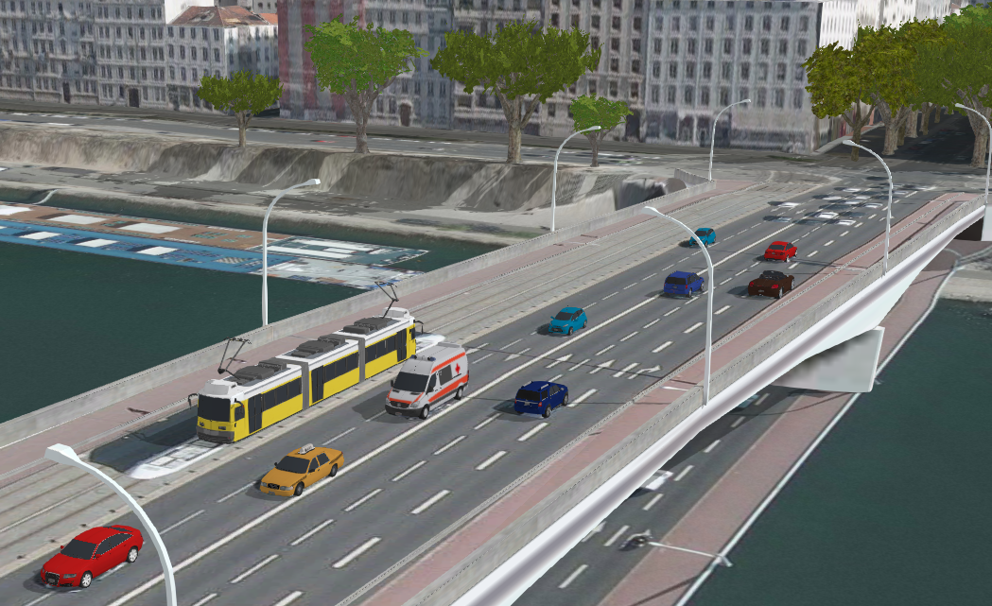
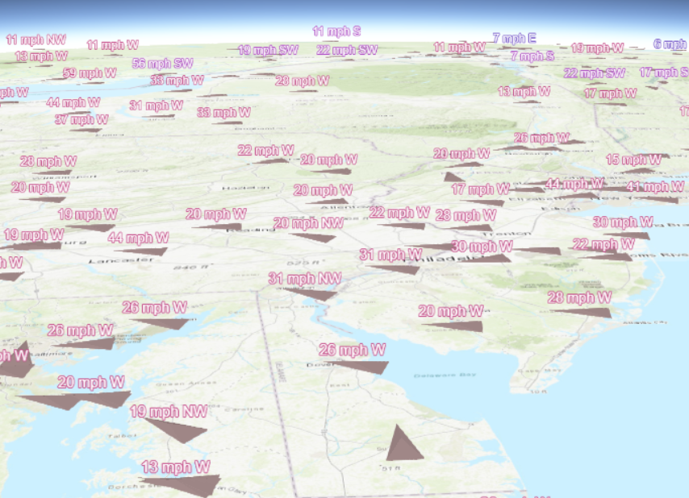
Multivariate mapping with visual variables
visualVariables - only for continuous numerical visualization
Color
Size
Rotation
Opacity

Slide 27
Examples
Notes:
G97350 UC Template for Esri staff

Slide 28
Edge Rendering
API Sample
Urban Development
Notes
Code
Live App
Urban Sketch
Notes
Code
Live App
More edge styles

Slide 29
Points with Callouts
Lyon points of interest
Hiking trails in the Swiss National Park

Slide 30
Underground
API Sample

Slide 31
Scene Background
API Sample
World’s Biggest Cities
Notes
Code & Tutorial
Live App

Slide 32
Point Clouds
Renderer Types
Color Modulation
Point Size and Density

Slide 33

Demos

Slide 34
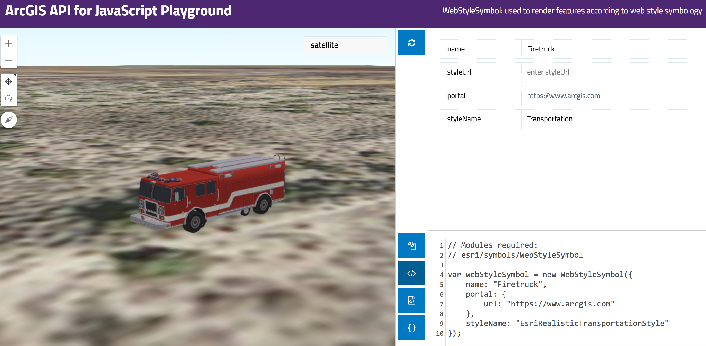
Resources
Get started with visualization
ArcGIS Blog
Icons, lines, fills
Objects, paths, extrusion
Real world sizes
Documentation
Renderer
Symbol3D
Symbol3DLayer

Slide 35

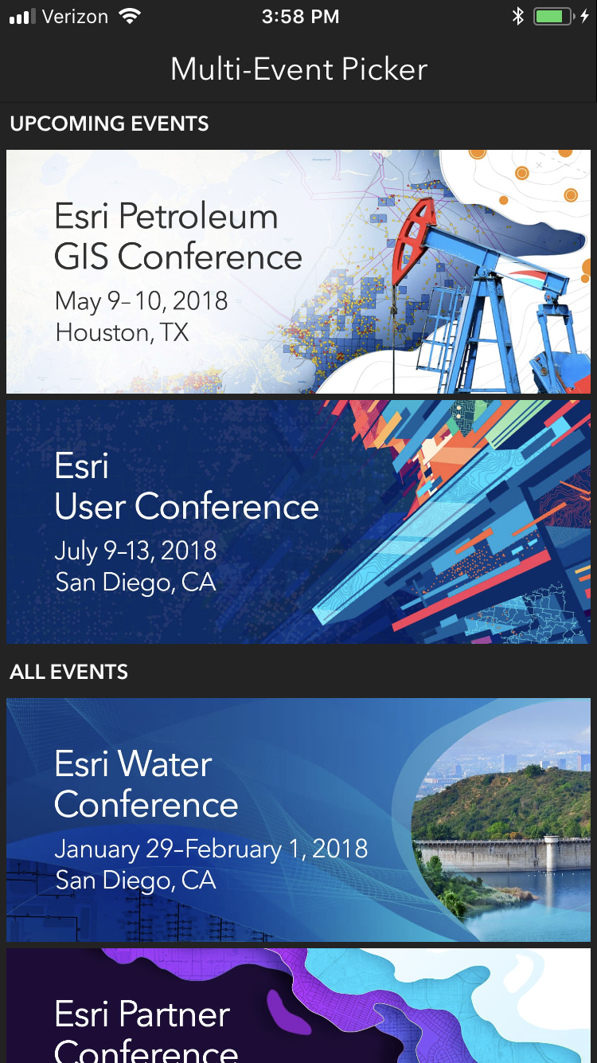
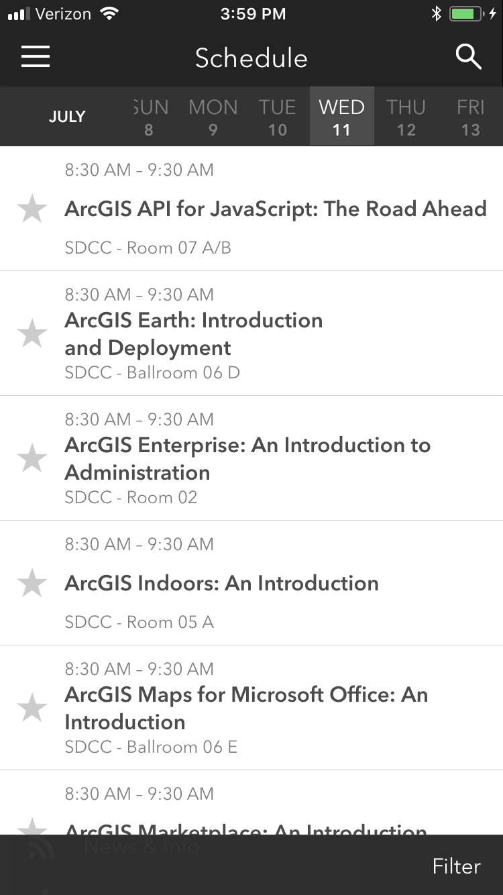
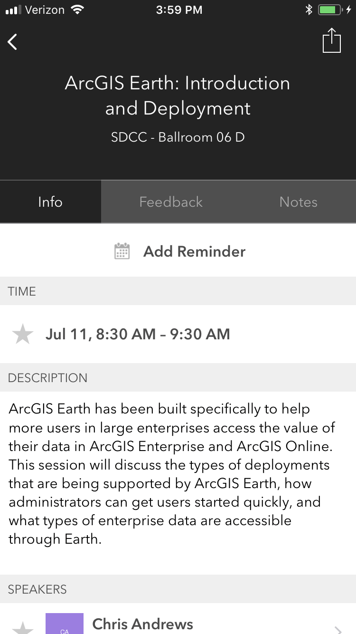
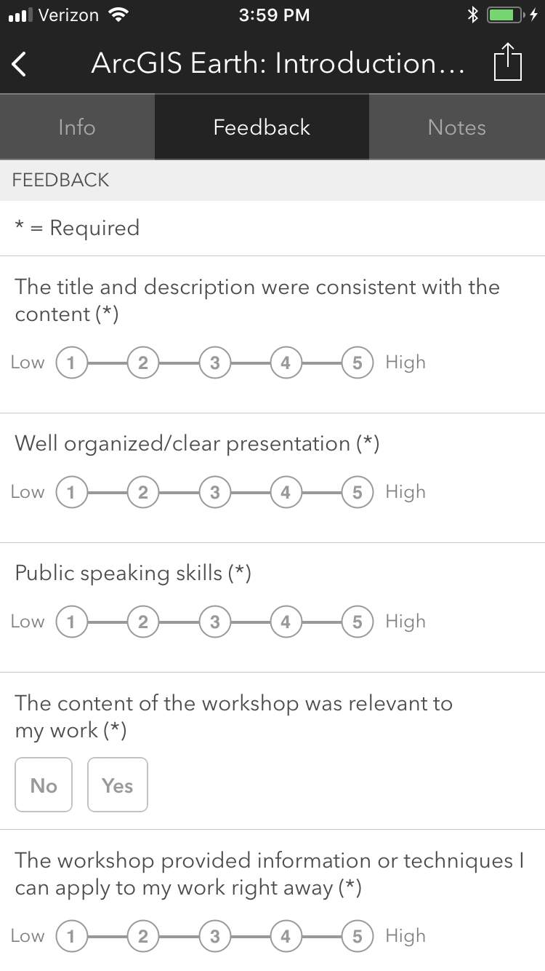


Please Take Our Survey on the App
Download the Esri Events app and find your event
Select the session you attended
Scroll down to find the feedback section
Complete answers
and select “Submit”

Slide 36
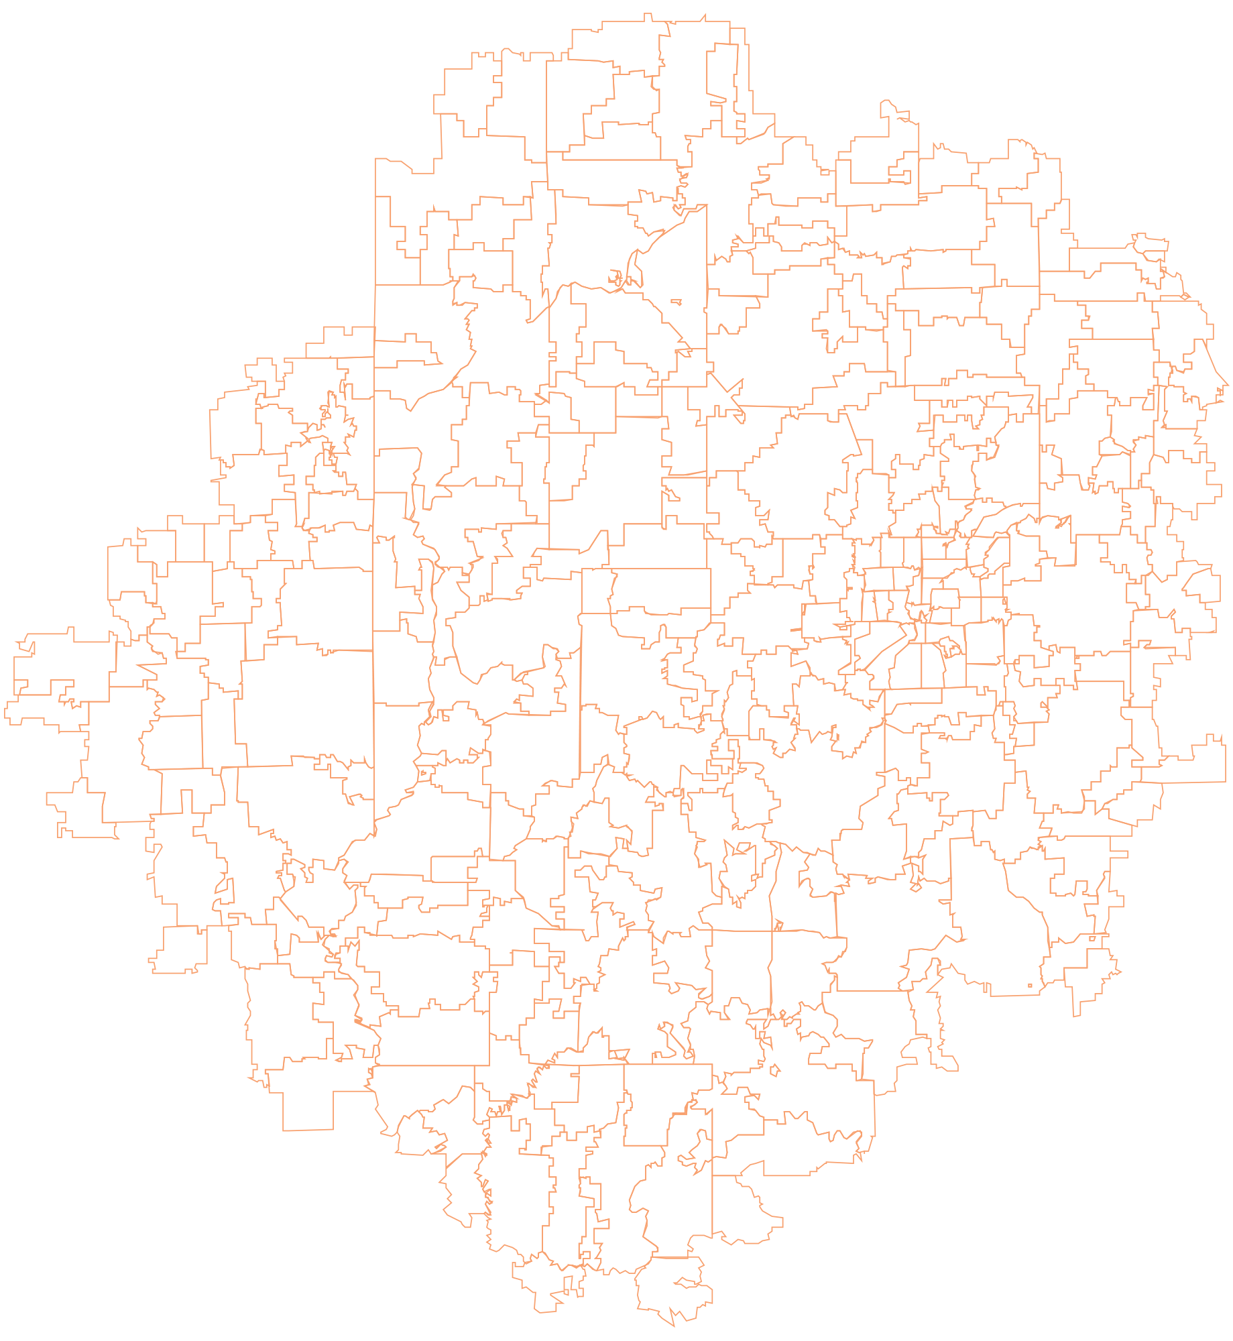


Notes:
G97350 UC Template for Esri staff

